Slide 1
Camera Orientation on TurboPi

Slide 2
Goals
Interface the camera and servo motors attached to the Turbo Pi
Use Python Programming to create a GUI that will let user orient the servo motor
Display the video taken from the oriented camera.
Become familiar with interfacing autonomous vehicle with Raspberry Pi through Python programming.

Slide 3
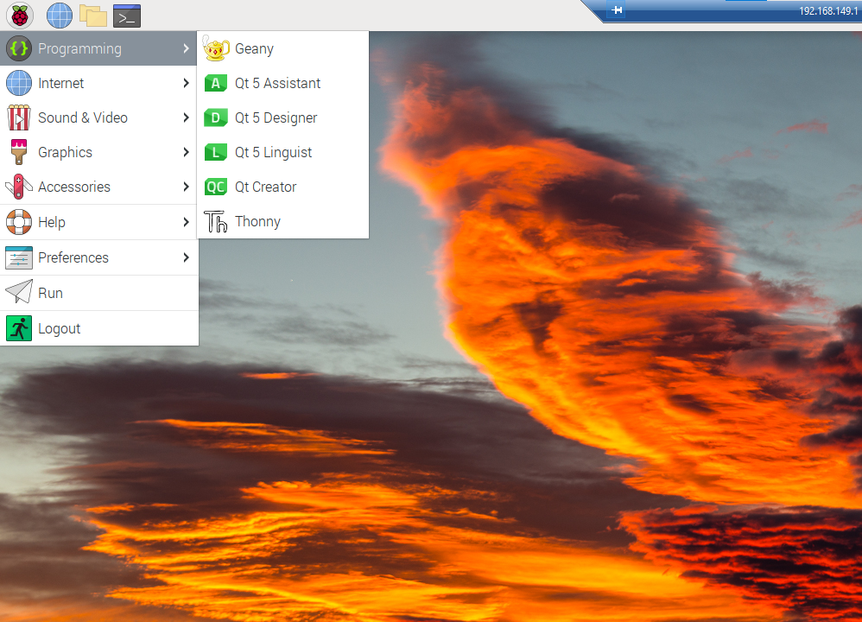
Opening the Files
Navigate to the Thonny IDE
Select the Raspberry Icon in the top-left corner
Hover over Programming
Select Thonny
When you open Thonny, enter the password: ml4hst2023

Slide 4
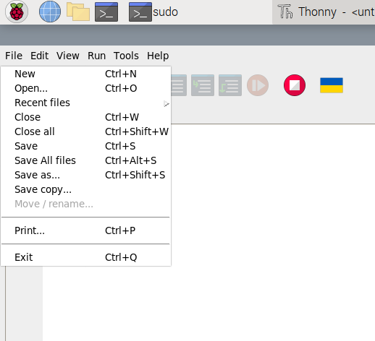
Opening the Files
To open files
Click on File in the top left
Select Open
Go to CameraServoOrientation directory
Select Servo_GUI.py

Slide 5
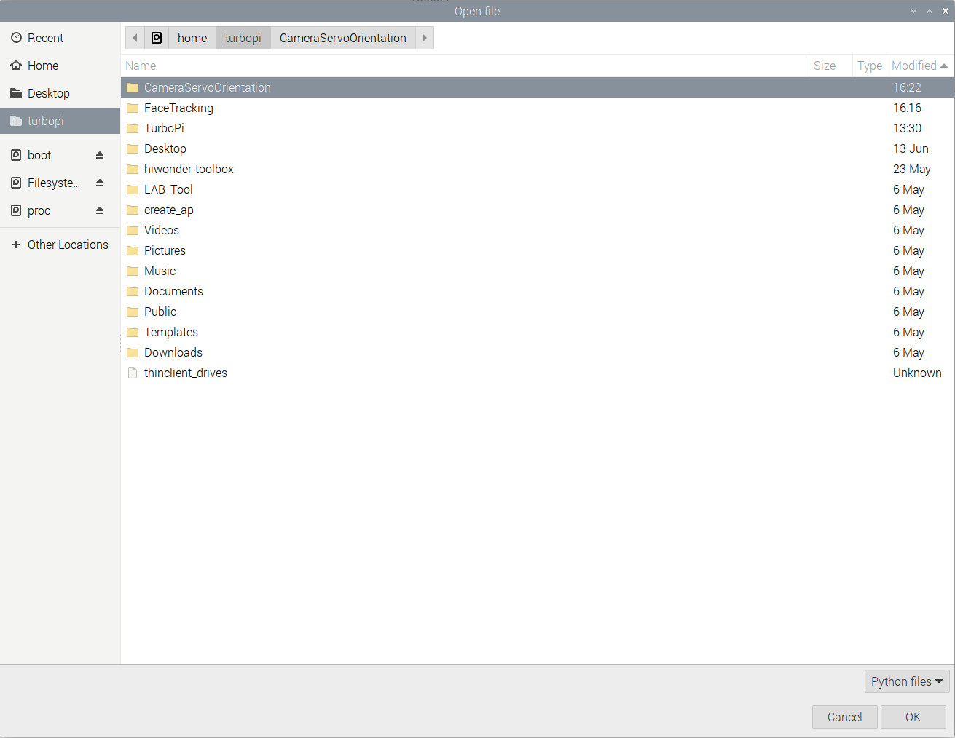
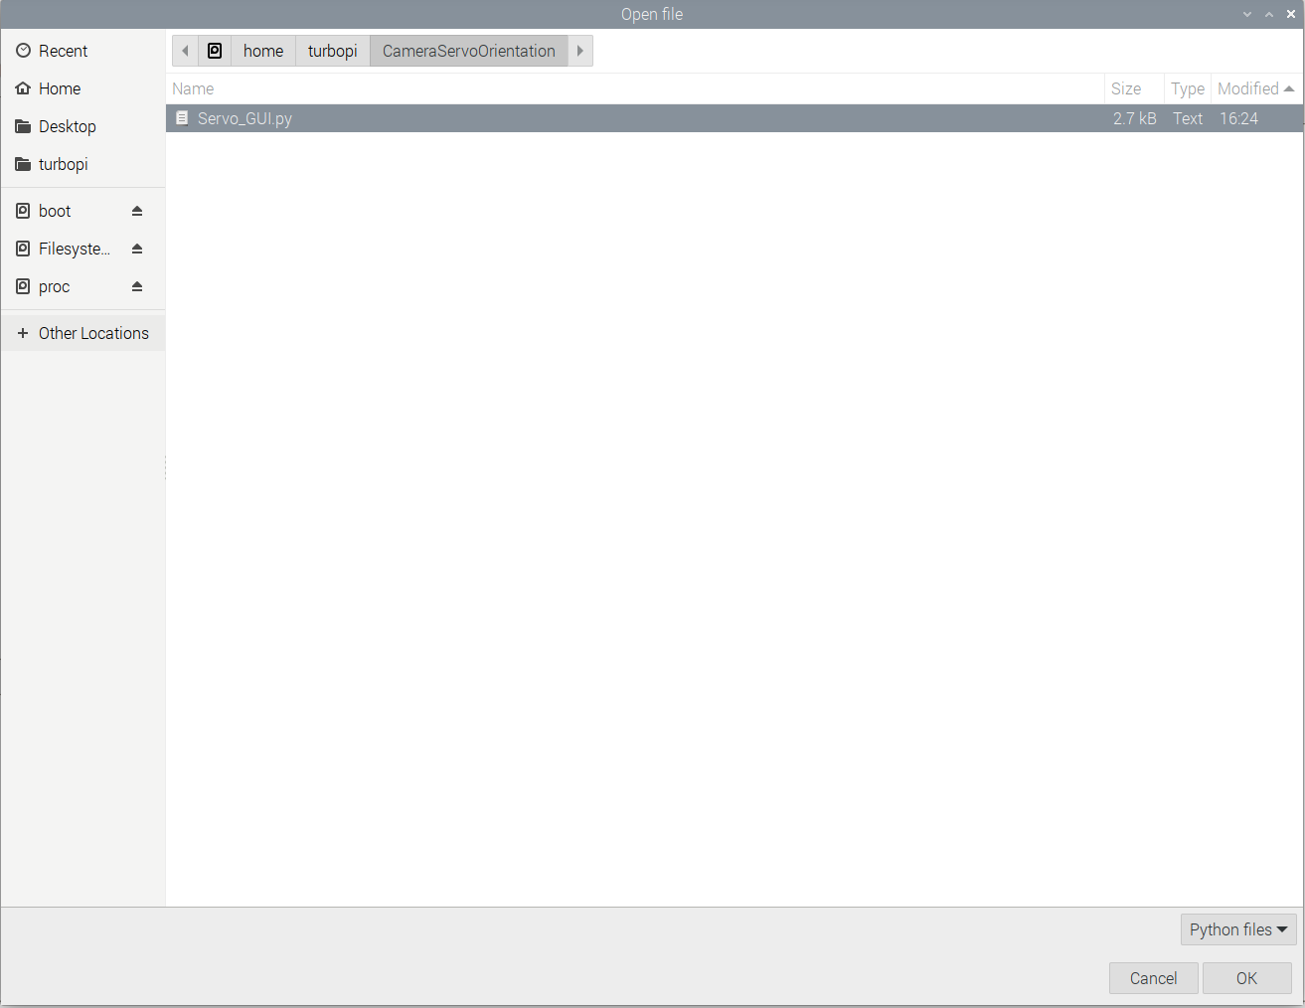
Opening the Files
1. Go to CameraServoOrientation
2. Double click on Servo_GUI.py

Slide 6
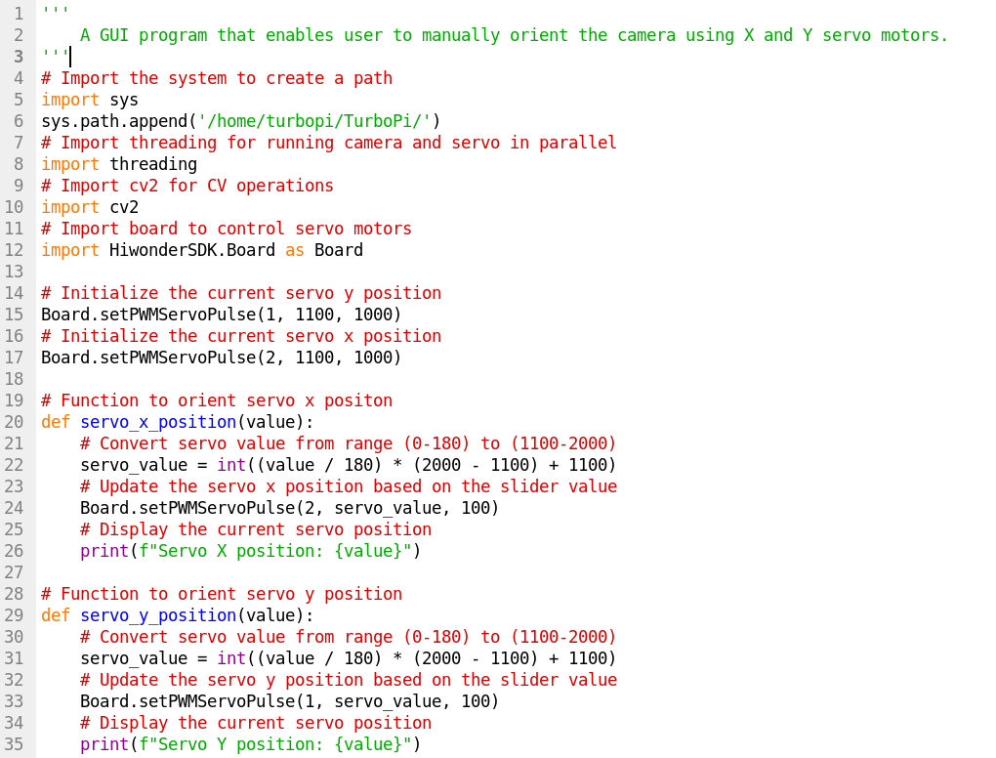
Code

Slide 7
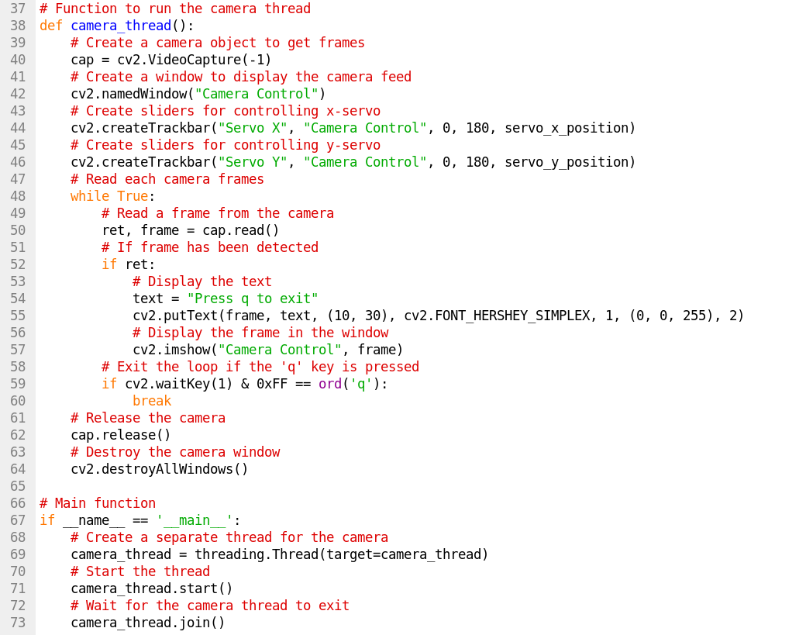
Code

Slide 8
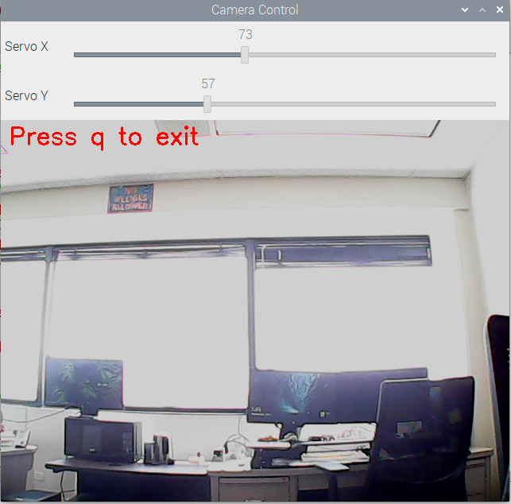
Running the Program
Run the Program
A GUI will be displayed showing servo controls and camera
Use the slider to orient camera vertically and horizontally
To exit the program, press q

